Slide 1
USEL SumoBots In Jamaica!
International Robotics
Opportunity
July 21st – 24th 2022

Slide 2
How Amazing is this Opportunity?
This international robotics tournament takes place in Kingston, Jamaica.

Slide 3
You are Invited!
International opportunities are difficult to come across and no other opportunity is guaranteed this year.
Participants will participate in various sanctioned robotics events.
Participants will meet and connect with kids from a different culture who have something in common. (Robotics)
20 USA Teams and 20 Jamaica Teams will be competing
Participants will experience the unique culture of Jamaica’s food, music, and incredible beaches.
The event will be a fun and memorable experience they will never forget.

Slide 4
What are the cost?
The tournament registration fee is $400 for participants and $300 for non-participants
Registration Fee Includes:
3 nights hotel at Altamont Court Hotel
Daily Breakfast
Ground transportation
Excursion + Lunch
Swag Bag*
Tournament Registration for WRO & Sumo*
Approximate cost for flights ranges from $520 - $880 with typical cost of $677.
Visitjamaica.com

Slide 5
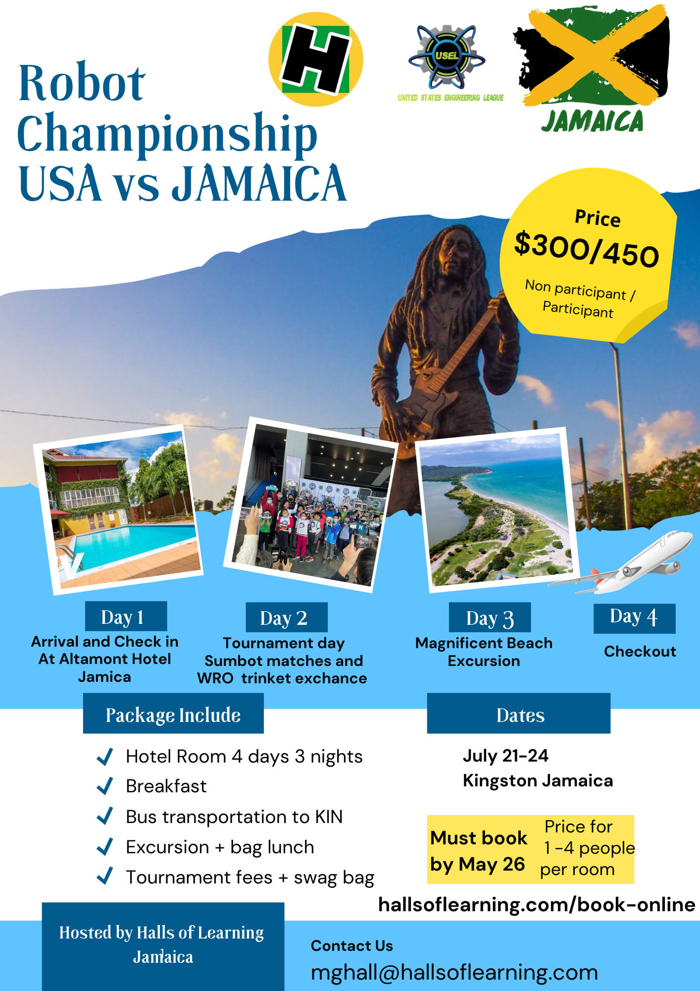
Trip Schedule
Day 1: Arrival and Check-In
Day 2: Tournament Day/trinket exchange
Day 3: Beach Day
Day 4: Checkout

Slide 6
How to Register
Confirm spot by registering online either paid in full or by $50 Deposit with Mr. Herm
Pay in full by May 26th, 2022
Confirm Flight information
*We Highly recommend booking your flights first**

Slide 7
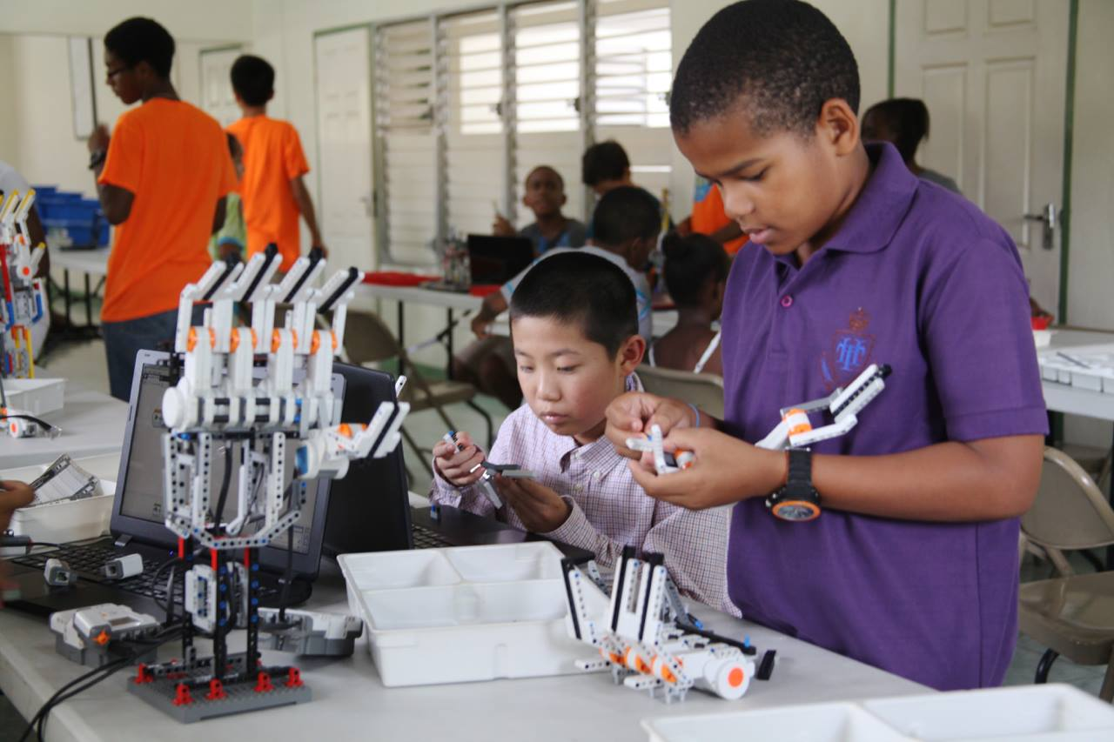
Deadline to Register
May 26th 2022
Covid Flight Information
ALL you need to travel to the island is a negative Antigen or PCR test result conducted within 3 days of travel, regardless of your vaccination status. Children under the age of 12 do not need a test result.
United States citizens: Travelers are required to show a negative COVID-19 viral test result taken no more than 1 day before travel, OR documentation of having recovered from COVID-19, before they board their flight.
https://www.visitjamaica.com/jamaica-cares/
hallsoflearning.com/book-online

Slide 8
Jamaica
“If you talk about it, it’s a dream, if you envision it, it’s possible, but if you schedule it, it’s real.” – Tony Robbins

Slide 9
THANK YOU!
Halls of Learning
Marvin G. Hall
Phone:
1 876 869 8862
Email:
mghall@hallsoflearning.com

Slide 10
Things to do in Kingston
Port Royal
Beaches of lime Cay
Hope Botanical gardens
Bob Marley Museum
Devon house
Hollywell recreational park
Trench town Culture yard

